Slide 1
Taxation for Health Promotion:
The Case for NCDs
Jeremias N. Paul Jr.
Coordinator, Tobacco Control Economics
Prevention of Noncommunicable Diseases
The views expressed herein are those of the presentor and should not be
attributed to the World Health Organization Executive Board and its management.

Slide 2
Presentation Outline
What is health promotion?
Fiscal policy as an instrument to address the risk factors of NCDs
Concluding Remarks
Verbov 2002

Slide 3
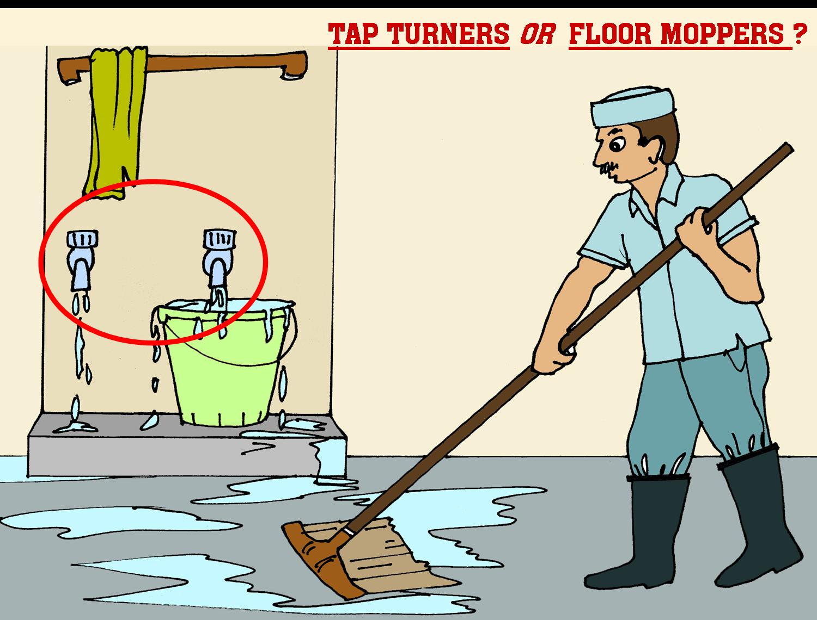
Question for the Day
Notes:
3

Slide 4
What is Health Promotion?
“the process of enabling people to increase control over and to improve their health”.
(The Ottawa Charter 1986)
Verbov 2002

Slide 5
HEALTH PROMOTION
The Lalonde Report 1974
Found out that despite 7.1% of GNP spent on health, Canadian’s health were not improving.
Showed over 70% of deaths were from heart disease and other chronic diseases.
Asserted that these premature illness and deaths was the result of environment and lifestyle factors.
Argued for a new perspective - a “health promotion strategy”
This began the modern era of Health Promotion.
Verbov 2002

Slide 6
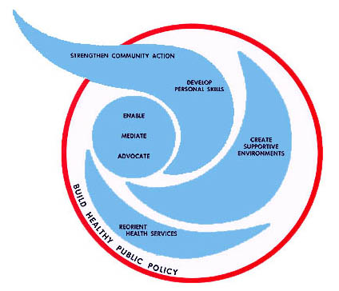
THE OTTAWA CHARTER OF HEALTH PROMOTION

Slide 7


Individual & Population Approaches
Truncate high risk end of exposure distribution (e.g. NCD obesity clinic). Clinical approach to disease prevention.
Reduce a little risk in most people (e.g. Dietary fat reduction, Physical Activity Campaign). Lifestyle change combined with an environmental approach.

Slide 8
Health Promotion can help generate and improve effective use of resources
social enterprise
public health intervention
Funds spent on keeping the population healthy versus treating the sick could improve efficiency within the same level of resources.
“wellness of all” can be a rallying point for mobilizing additional social, political and economic capital

Slide 9
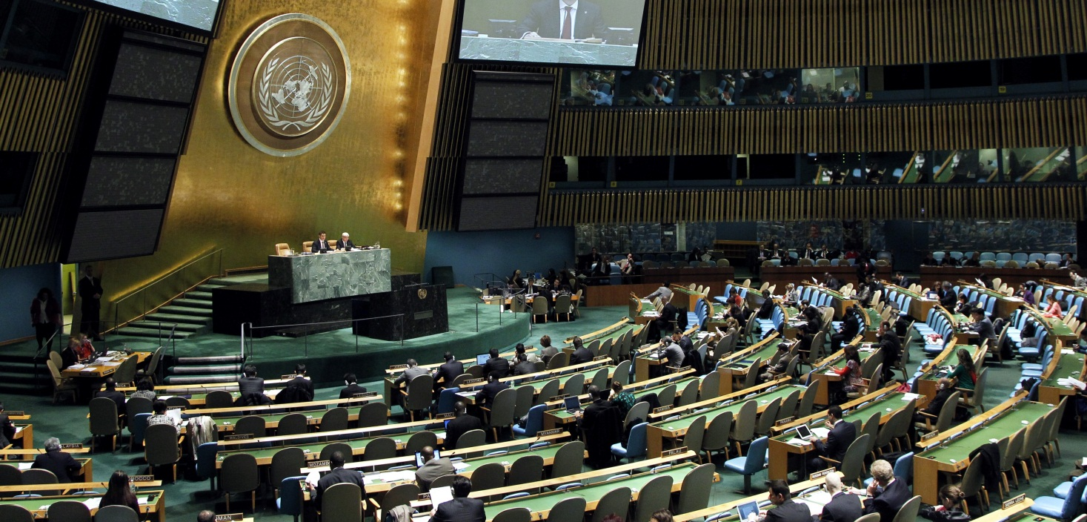
United Nations General Assembly
"We, Heads of State and Government, assembled at the United Nations on 19 and 20 September 2011, acknowledge that the global burden and threat of non-communicable diseases constitutes one of the major challenges for development in the 21st century"
Paragraph 1 –
Resolution A/RES/66/2
2011 UN Political Declaration on NCDs

Slide 10
Risk factors for Noncommunicable Diseases (NCDs)
 |  | Causative risk factors
 |  | Tobacco use | Unhealthy diets | Physical inactivity | Harmful use of alcohol
Noncommunicable diseases | Heart disease and stroke | ✓ | ✓ | ✓ | ✓
 | Diabetes | ✓ | ✓ | ✓ | ✓
 | Cancer | ✓ | ✓ | ✓ | ✓
 | Chronic lung disease | ✓

Slide 11

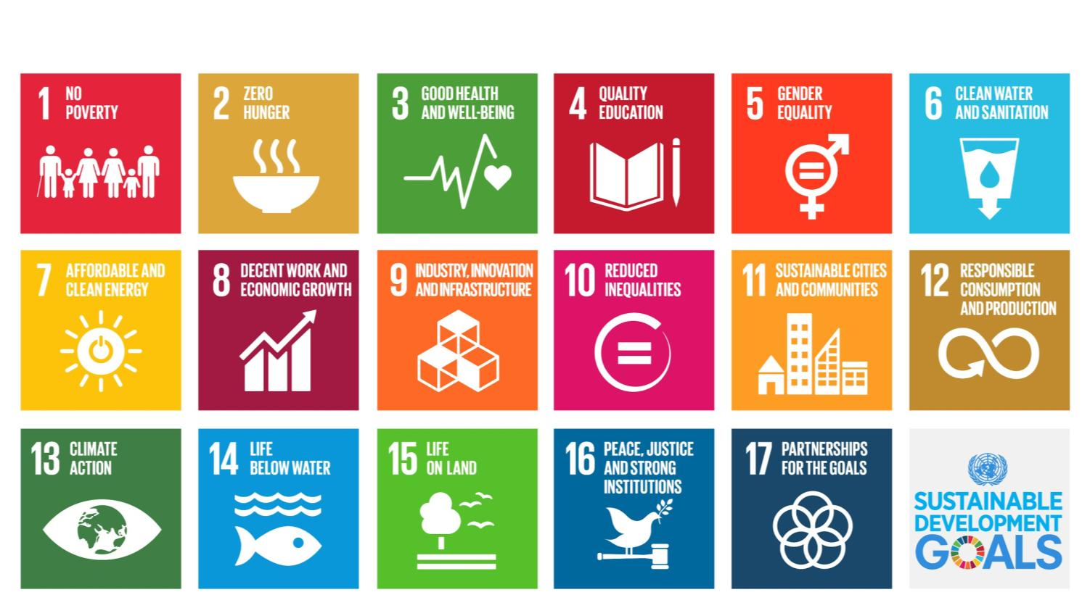

NCDs included in the 2030 Agenda for Sustainable Development

Slide 12
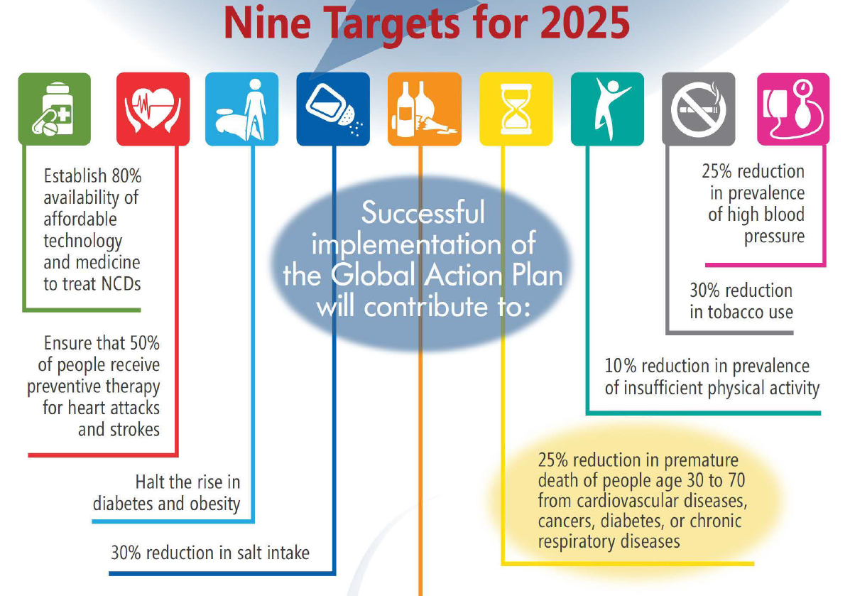
WHO Global Monitoring Framework on NCDs:
9 voluntary global NCD targets to be attained by 2025
A 25% relative reduction in risk of premature mortality from cardiovascular disease, cancer, diabetes or chronic respiratory diseases
At least a 10% relative reduction in the harmful use of alcohol
A 10% relative reduction in prevalence of insufficient physical activity
A 25% relative reduction in prevalence of raised blood pressure or contain the prevalence of raised blood pressure
A 30% relative reduction in prevalence of current tobacco use
An 80% availability of the affordable basic technologies and essential medicines, incl. generics, required to treat NCDs
At least 50% of eligible people receive drug therapy and counselling to prevent heart attacks and strokes
A 30% relative reduction in mean population intake of salt/sodium
Halt the rise in diabetes and obesity

Slide 13
The Ottawa Conference - 1986
The Ottawa Charter for Health Promotion
Build Healthy Public Policies
Create supportive environments
Strengthen community action
Develop personal skills
Reorient health services

Slide 14
Taxation as an instrument for a healthy public policy
From an economic perspective, why should we increase taxes on tobacco, alcohol and unhealthy food products vs. other products?
Economic justification: correct for market failures and negative externalities
  Harm imposed on society is not accounted for in the market price
  Market price doesn’t account for future consequences of current actions
Public health justification: increased taxes and prices effectively reduce their use and their consequent health burden
  Increases in taxes that increase prices reduce consumption through increased cessation, reduced initiation and reduces intensity by continuing users
Public finance justification: higher taxes are an efficient way to raise revenues
  Because the demand for these products are price inelastic, increases in taxes will result in increased revenues even as consumption declines
  Increased revenues can be used to improve health and development
Notes:
Economists are usually uncomfortable with changing prices of particular products.
But are all for taxing products that cause market failures
14

Slide 15
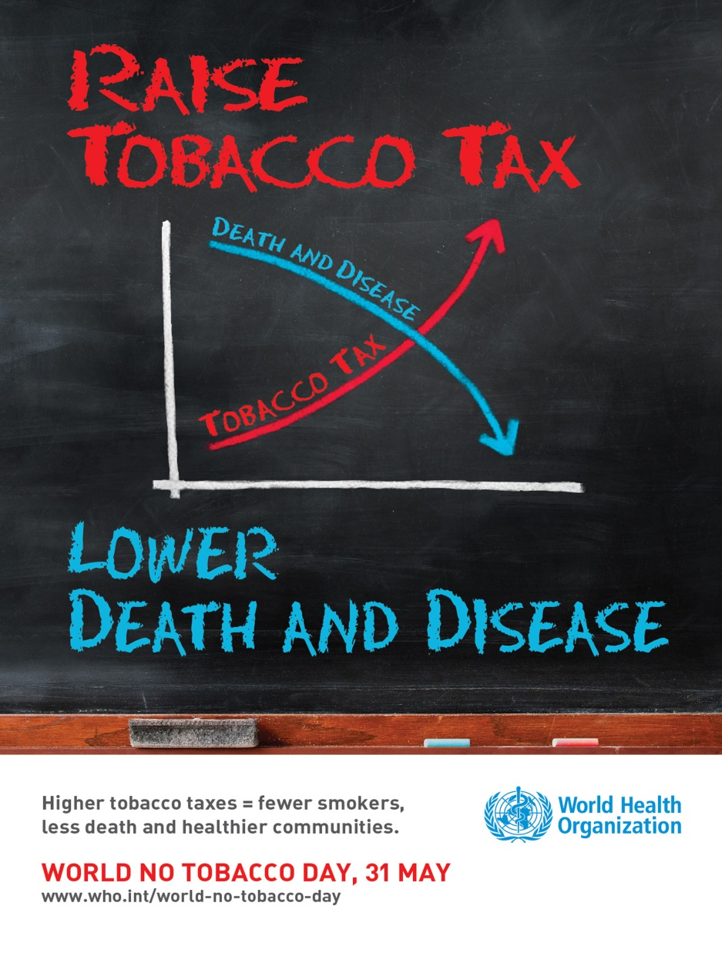
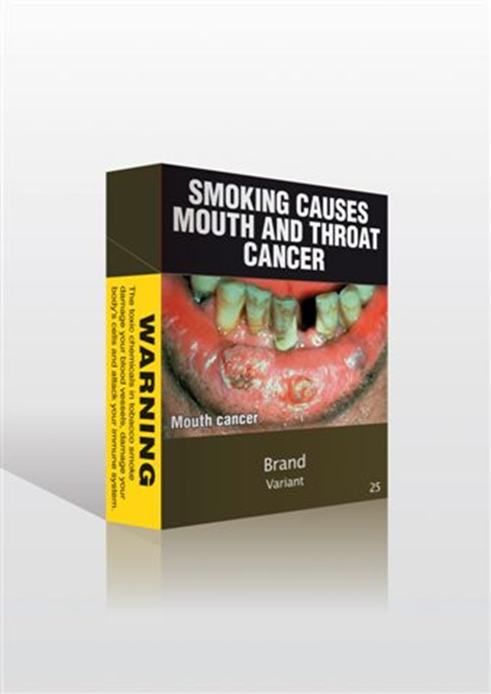
Building healthy public policy to reduce tobacco use
Verbov 2002

Slide 16
Smoking kills ...
Tobacco currently kills nearly 6 Million/year but this will increase to over 8 Million/year by 2030, or 10% of all deaths projected to occur that year.
100 million deaths were caused by tobacco in the 20th century.
If current trends continue, tobacco could kill up to 1 Billion
in the 21st Century unless urgent action is taken

Slide 17
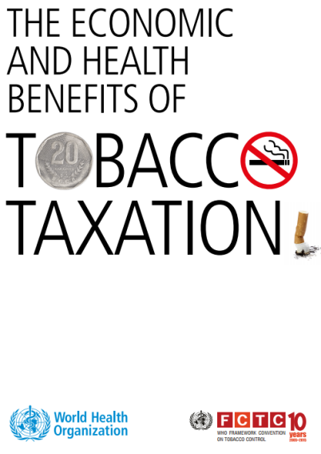
Tobacco tax as a revenue stream for financing for development
The Addis Ababa Action Agenda recognizes that price and tax measures on tobacco represent a revenue stream for financing for development in many countries
Governments already collect nearly US$270 billion in tobacco excise revenues each year
Tobacco taxation offers a win-win policy option for governments
Increased tobacco taxes can bring in important revenue to finance the SDGs
WHO FCTC implementation is a target of the SDGs

Slide 18
South Africa
Raising excise taxes increases prices and reduces consumption

Slide 19
Smoking prevalence in South Africa:
There are 4 million fewer smokers than there would have been

Slide 20
Philippine Tobacco Tax Reform Path at a Glance
Premium
Tier 1
Unitary
Tier 2
High
Medium
Low
341%
Key Features
Simplified tax structure - multi-tiered to unitary by 2017.
Significantly increased tobacco taxes for health reasons (341% in year 1)
Tax rates automatically increase 4% annually starting 2017 to account for inflation.
Bulk of incremental revenues earmarked for Universal Health Care.
Safety nets for tobacco farmers/others.
In Billion Pesos | 2013 | 2014 | 2015 | 2016 | 2017
Projected Incremental Revenue (Tobacco) | 23.4 | 29.6 | 33.5 | 37.1 | 40.9
Projected Incremental Revenue (Alcohol) | 10.6 | 13.3 | 17.1 | 19.8 | 23.3
Projected Incremental Revenue (Total) | 34.0 | 42.9 | 50.6 | 56.9 | 64.2
Estimated Earmark for Health as of 2012 | 30.5 | 38.4 | 45.6 | 51.3 | 58.0

Slide 21
Win for Revenues
Share of tobacco and alcohol excise collections to GDP in 2015.
Source: BIR and NSCB

Slide 22
Win for Public Health
$ 2.0 B
$ 1.9 B
$ 1.3 B
$ 1.0 B
$ 0.7 B
$ 0.4 B
$ 0.5 B
$ 0.5 B
$ 0.2 B
Source: GAA, DBM

Slide 23
Philippines
Raising tobacco taxes is Good for Revenues, Good for Health
Source: BIR

Slide 24
Prevalence of Never, Current and Former Smokers. Philippines, NNS 1998-2015 (Dr. Dan’s Study)
Prevalence (%)
70
63.7
Never Smoker
59.1
60
54.5
55.0
54.3
50
Current Smoker
40
34.8
32.7
31.0
30
25.4
23.3
20
Former Smoker
10
14.7
15.5
12.8
13.0
10.2
0
1998
2003
2008
2013
2015

Slide 25
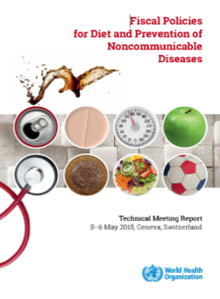
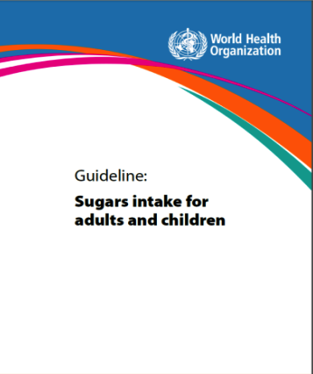
Building healthy public policy to reduce childhood obesity
Verbov 2002

Slide 26
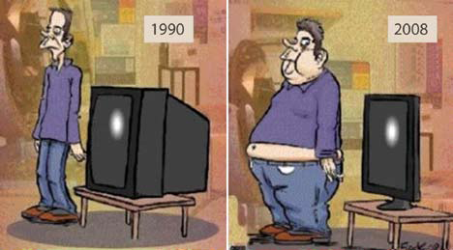
Overweight and obesity trends rising…

Slide 27
Infant and young child overweight trends (2008)
20
15
10
5
0
1990
1995
2000
2005
2010
2015
Low-income
Lower-middle-income
Upper-middle-income
High-income
Notes:
Overweight in children is rising in all regions and all income groups. The fastest rise is seen in the lower middle income group. Over 40 million pre-school children were estimated to be overweight in 2008.
Overweight children are likely to become obese adults.
Overweight children might experience breathing difficulties, increased risk of fractures and psychological difficulties (poor self-esteem).
They are more likely than non-overweight children to develop diabetes and cardiovascular diseases at a younger age.

Slide 28
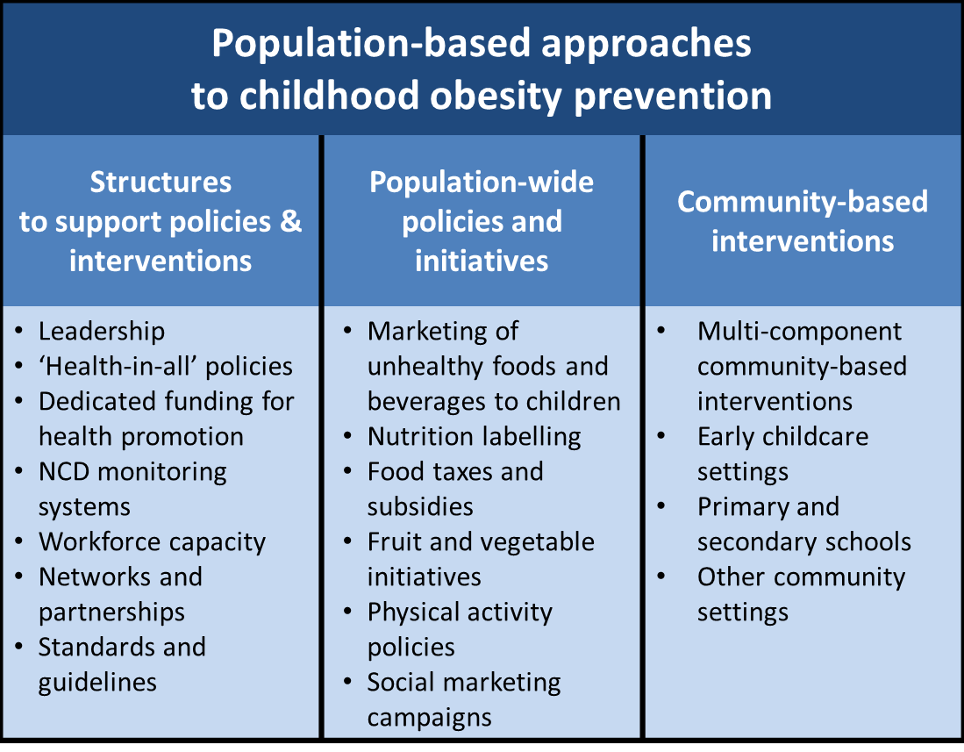
Fiscal policies are a key component of a comprehensive policy package

Slide 29
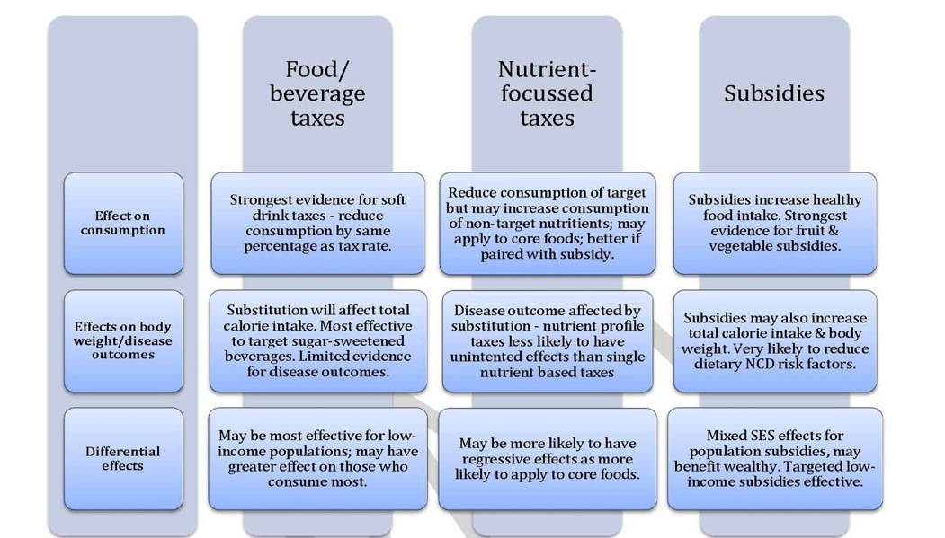
What do we know?

Slide 30
Technical Meeting on Fiscal Policies for Diet and Prevention of NCDs (Geneva, May 2015)
Appropriately designed fiscal policies have considerable potential for promoting healthier diets and improving weight outcomes
Taxes that raise the prices of sugar sweetened beverages by 20 % or more could lead to more than proportional reductions in SSB consumption and net reductions in caloric intake
Subsidies for fresh fruits and vegetables that reduce their prices by 10 to 30 % are effective in increasing fruit and vegetable consumption. The combination of such subsidies and taxation has greater effect
Taxation of other unhealthy foods and non-alcoholic beverages, appears promising

Slide 31
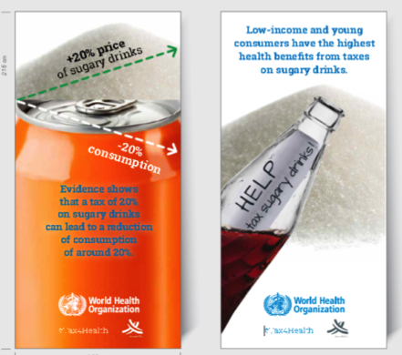
Technical Meeting on Fiscal Policies for Diet and Prevention of NCDs
Vulnerable populations (ie the poor, the young) are most responsive to changes in the relative prices of healthier and less healthy foods and beverages.
Specific excise are likely to be most effective but needs to be regularly adjusted with inflation.
Earmarking of tax revenue is challenging in some countries but dedicating the revenues for targeted health programs aligns with its health objective and can be used to strengthen capacity for tax administration (i.e. for monitoring and enforcement).

Slide 32
CONCLUDING REMARKS
An ounce of prevention is better than a pound of cure. There needs to be a paradigm shift and think holistically about health and its social determinants in the context of the Sustainable Development Goals.
Fiscal authorities should support Health Promotion from the revenue and expenditure sides of the equation. Many health promotion measures are very cost effective as they emphasize prevention rather than cure.

Slide 33
CONCLUDING REMARKS
Raising tobacco taxes is a proven strategy to generate substantial revenues for governments. It is a win-win formula for improving both fiscal and public health outcomes.
Sin Tax Reform in the Philippines generated US$3.9 billion in incremental revenues in its first three years of implementation with 80% of the increase accounted for by tobacco taxes. This enabled the Philippine government to expand coverage and provide free health insurance for the poor and the near poor.

Slide 34
CONCLUDING REMARKS
The road to reform is not easy. Anticipate the SCARE tactics of the tobacco industry and be prepared to apply pre-emptive moves and countermeasures. Similar tactics may be employed by the unhealthy food and beverage industry.
  S – Smuggling and illicit trade
  C – Court and legal challenges
  A – Anti-poor rhetoric
  R – Revenues will go down not up
  E – Employment related problems

Slide 35
Which is a better approach?
Notes:
35

Slide 36
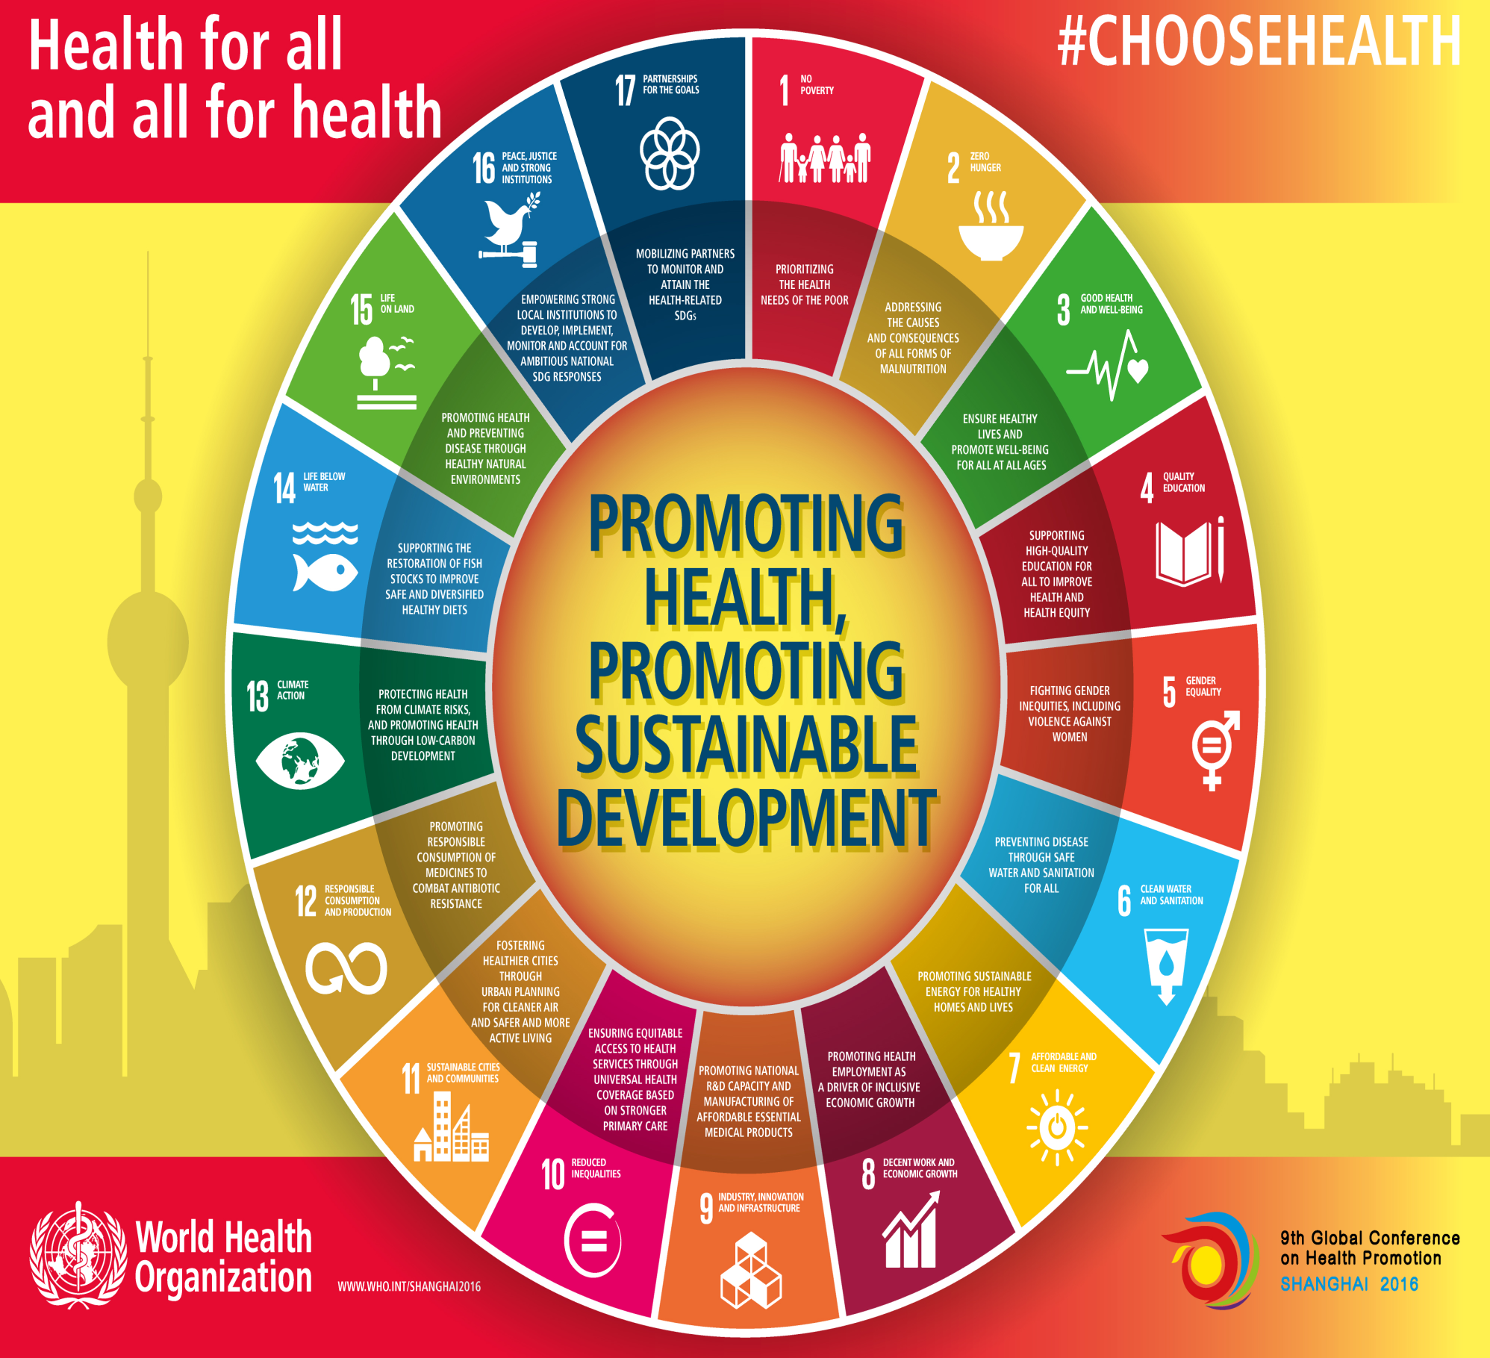

Slide 37
THANK YOU

